Slide 1
OOGAValley Sprint 2 Demo
Jason Qiu and Spencer Katz

Slide 2
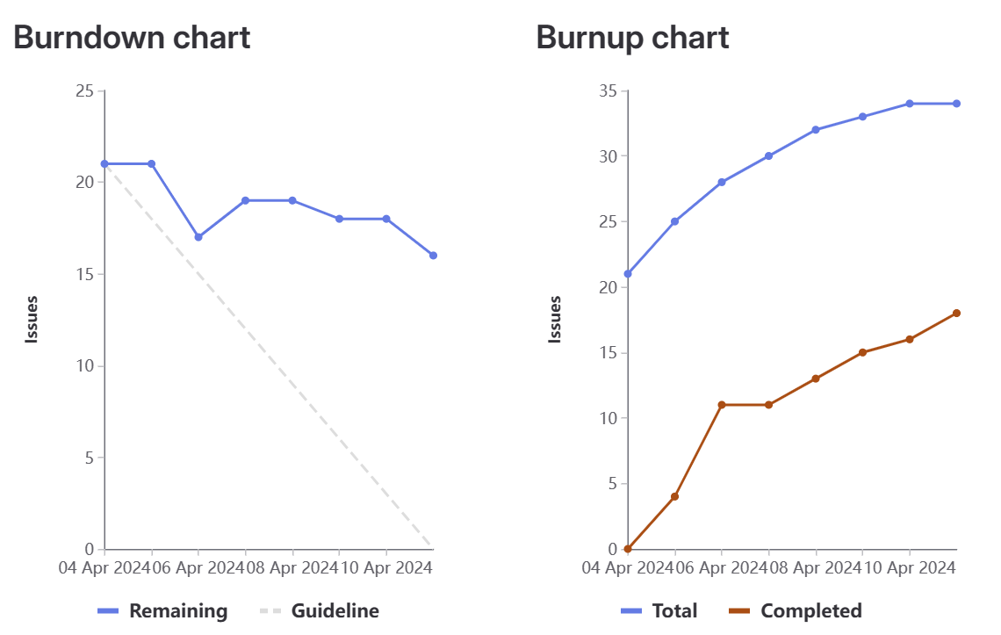
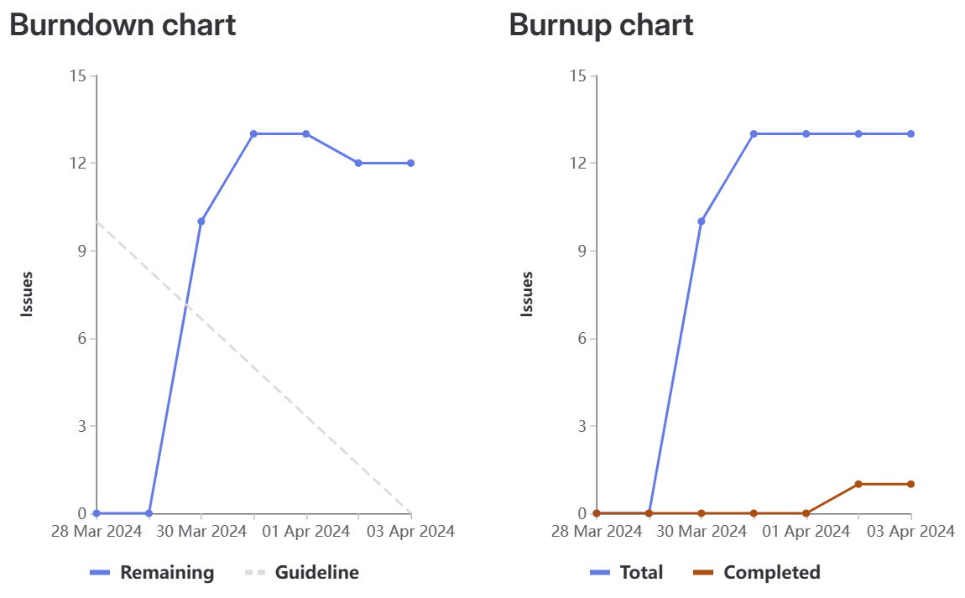
Sprint 2 Review
2x more work accomplished this sprint compared to last sprint
Sprint 1

Slide 3
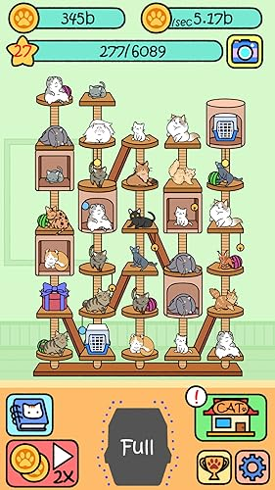
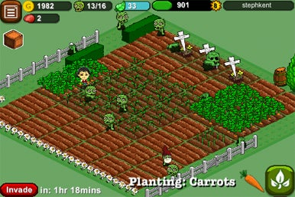
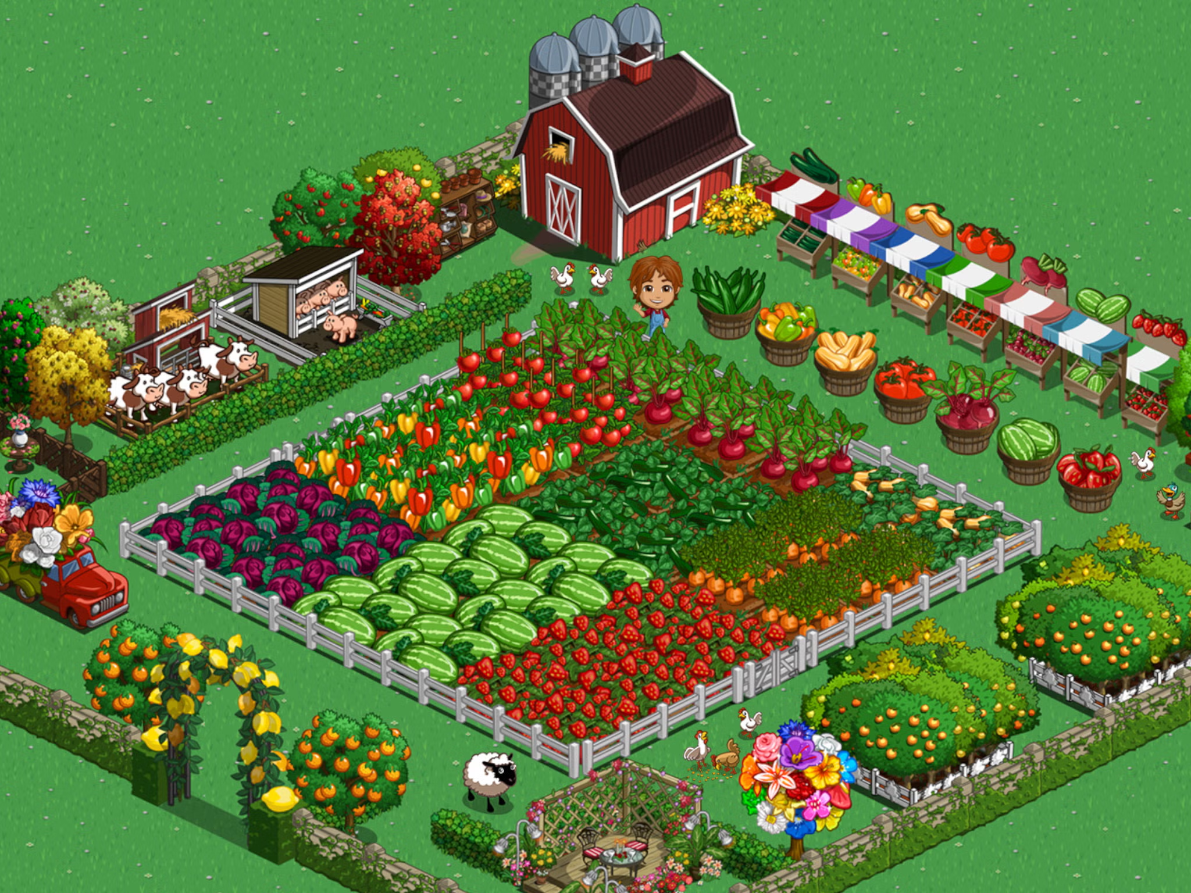
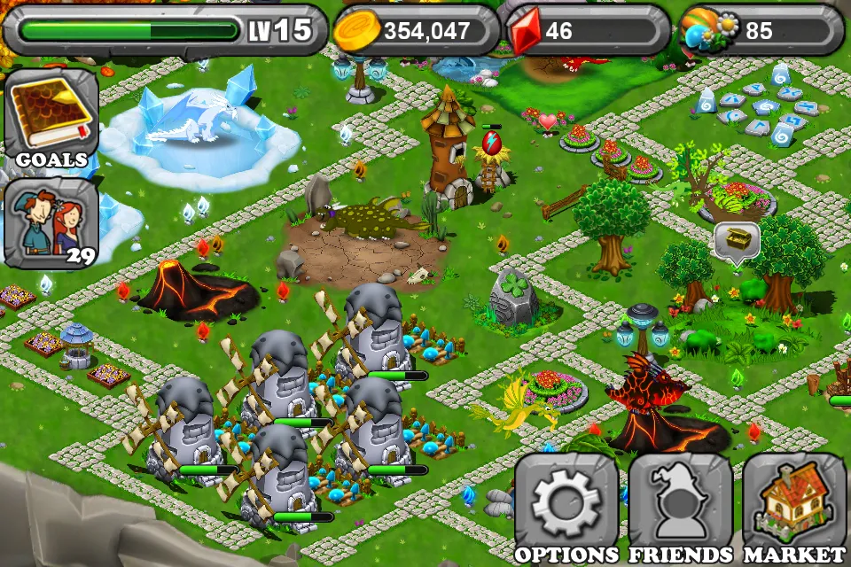
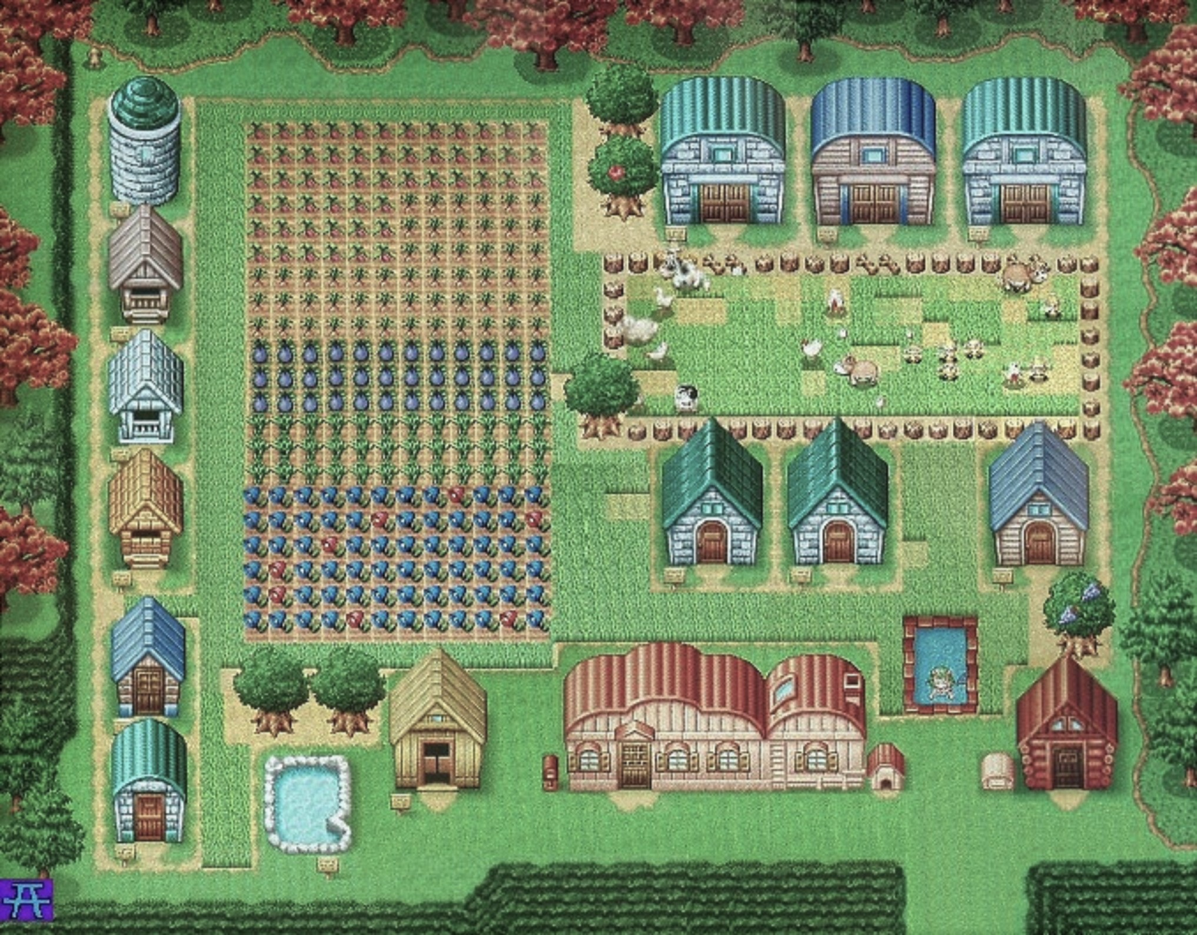
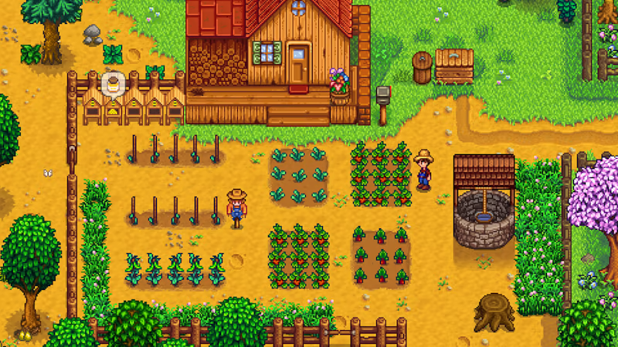
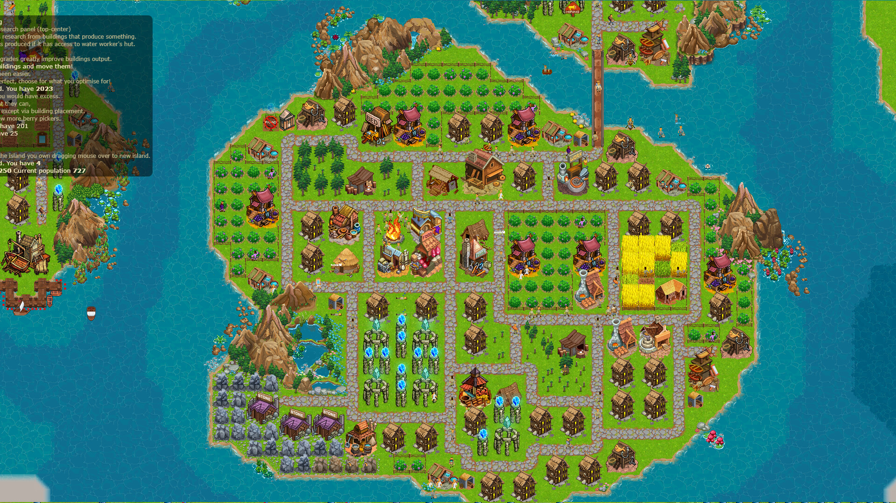
What kind of games can you make?

Slide 4
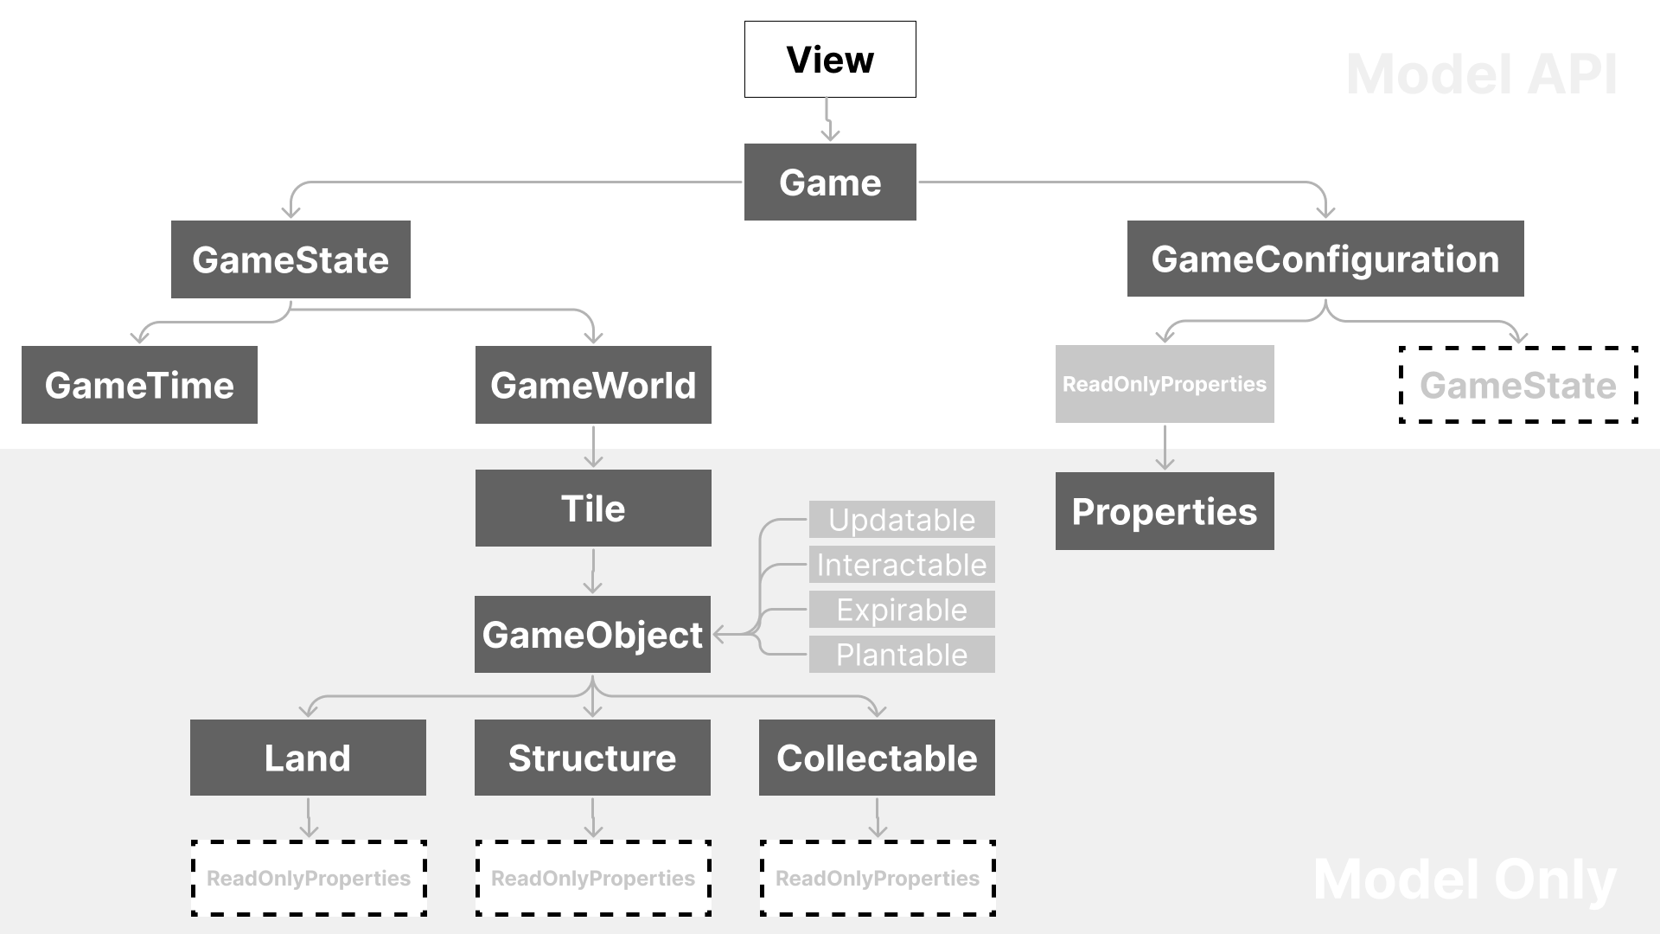

Slide 5
Alternate design for how to handle “layering” in the world:
GameWorld holds a 2D array/map for every single layer and has to manage them all (including interactions between them)
Instead, having each cell/tile manage its own layers makes much more sense
GameWorld can just handle updating and interacting with the tiles

Slide 6
Closed (inner logic):
Game (game loop)
GameState
GameTime
GameWorld
Tile
Open (via configuration):
GameTime
Land
Structure
Collectable

Slide 7
Closed (inner logic):
GameConfiguration
Properties
Open (via configuration):
GameConfiguration rules (Properties)

Slide 8
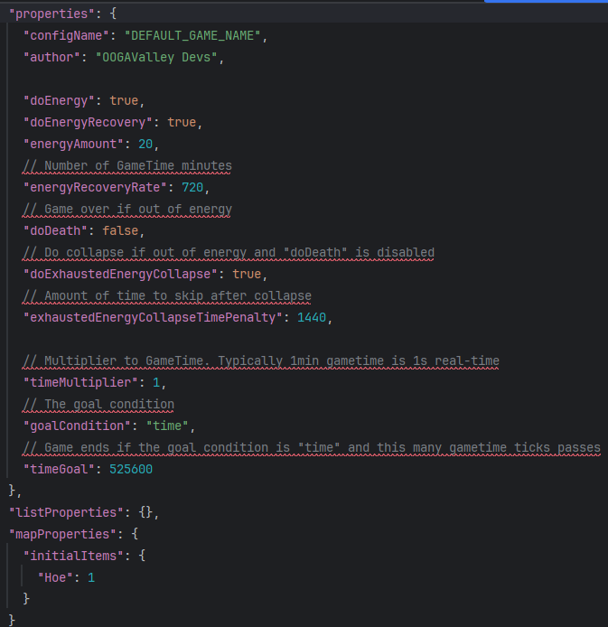
What does our data-driven game-making look like?
JSON for all kinds of rules, land, structures, and collectables
Configurable behaviors for each game object too
Configurable directly in the editor (WIP)

Slide 9
Sprint 3 Focus
Content (and potential concerns):
Integration of the model and the view
Basic game configurations to show off
Workflow (lessons learned from Sprint 2):
START first making an issue, assigning yourself, and creating a branch and merge request BEFORE doing any work (avoid invisible work)
START referring to a specific issue on all commit messages
KEEP communicating with relevant team members to stay on the same page
STOP committing and pushing directly to the main branch

Slide 10
Planned Extensions
Basic:
Live game editing
Help system (via templates and help buttons)
Challenging:
Play Modes
Time Attack (Get as much money as you can in a certain amount of time)
Speedrun (Get a certain amount of an item as fast as possible)

